Slide 1

Google Capstone Project - I
(Cyclistic Bike Share)
By Aniket Parab
27/10/22

Slide 2
About Cyclistic:
Bike share offering based in Chicago
5,824+ Bikes Geo tracked into 692+ stations
Includes Reclining, Hand tricycle, and Cargo bikes
People use bikes for Leisure, Commute, etc.
Single-ride or Day-pass Users --> Casual Riders
Annual Membership Users --> Member Riders

Slide 3
Characters and Teams:
Lily Moreno:
Director of Marketing and my Manager
Cyclistic marketing analytics team:
Team responsible to guide marketing strategy
Cyclistic executive team:
Team that approves marketing strategy

Slide 4
Scenario:
As Junior Data Analyst, design strategy to:
Casual Riders --> Member Riders
Marketing strategy to be approved by Executives
Backed by compelling Data Insights and Visualization
Moreno divided goals into Business Questions
Shared access rights to Data Source

Slide 5
Business Questions:
How do Annual and Casual Riders use services differently?*
Why would Casual riders opt for Annual Membership?
How can Cyclistic use Digital Media to convert Casual riders to Members?
(*Note: Only first business question is assigned to me)

Slide 6
Data Sources:
This is Data Source under Policy
I used Data from Jan2021 – Dec2021

Slide 7
Data Processing:
Tool used: Python
Concatenated 12mo. Data --> single DataFrame
Casted required fields to appropriate DataTypes
Filtered required fields
Added additional fields to support analysis
Cleaned few rows based on certain criteria*
(*Note: For certain trips, end_time/ start_time is wrongly entered. This resulting into questionable trip_duration(calculated field). But only 0.012% entries contribute to mentioned case and hence it is removed.)

Slide 8
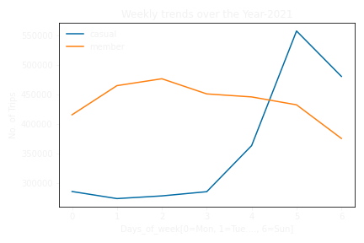
Analysis – Weekly Trend:
In weekly trend we can conclude:
Casual Riders use Cyclistic for Leisure or other purpose
Whereas Members use it for Office commutes

Slide 9
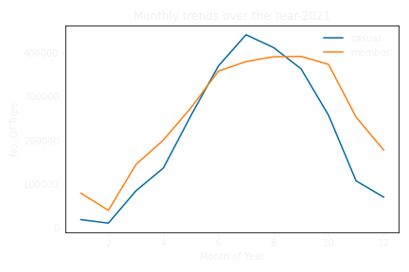
Analysis – Annual Trend:
In annual trend we can conclude:
Spike in July for Casual riders is due to increase in no. Of tourists visiting Chicago
As per one article, this is due to:
Good weather conditions
Local/ cultural event

Slide 10
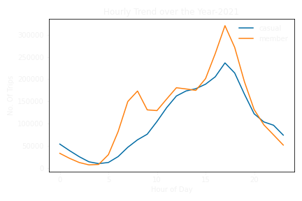
Analysis – Daily Trend:
In Daily trend we strengthen previous observations:
Member riders use Cyclistic for commute to Office or related work
Namely, Casual riders use platform more excluding general office hours maybe for leisure or fitness

Slide 11
Conclusion:
Casual Riders include:
Locals – Alternative to Public Transport
Tourists – Getting from point A --> Point B
For Member Riders:
Locals – For office commutes and other related commutes like Gym café, etc.

Slide 12
Suggestion:
To convert Casual --> Member:
Need of new plan
(Limited free rides)*weekdays + (More free rides)*weekends
To be clubbed with other fitness related social campaign
Reward casual riders after they bring Bicycles from Crowded to Free docking locations

Slide 13
Thank You

